Slide 1
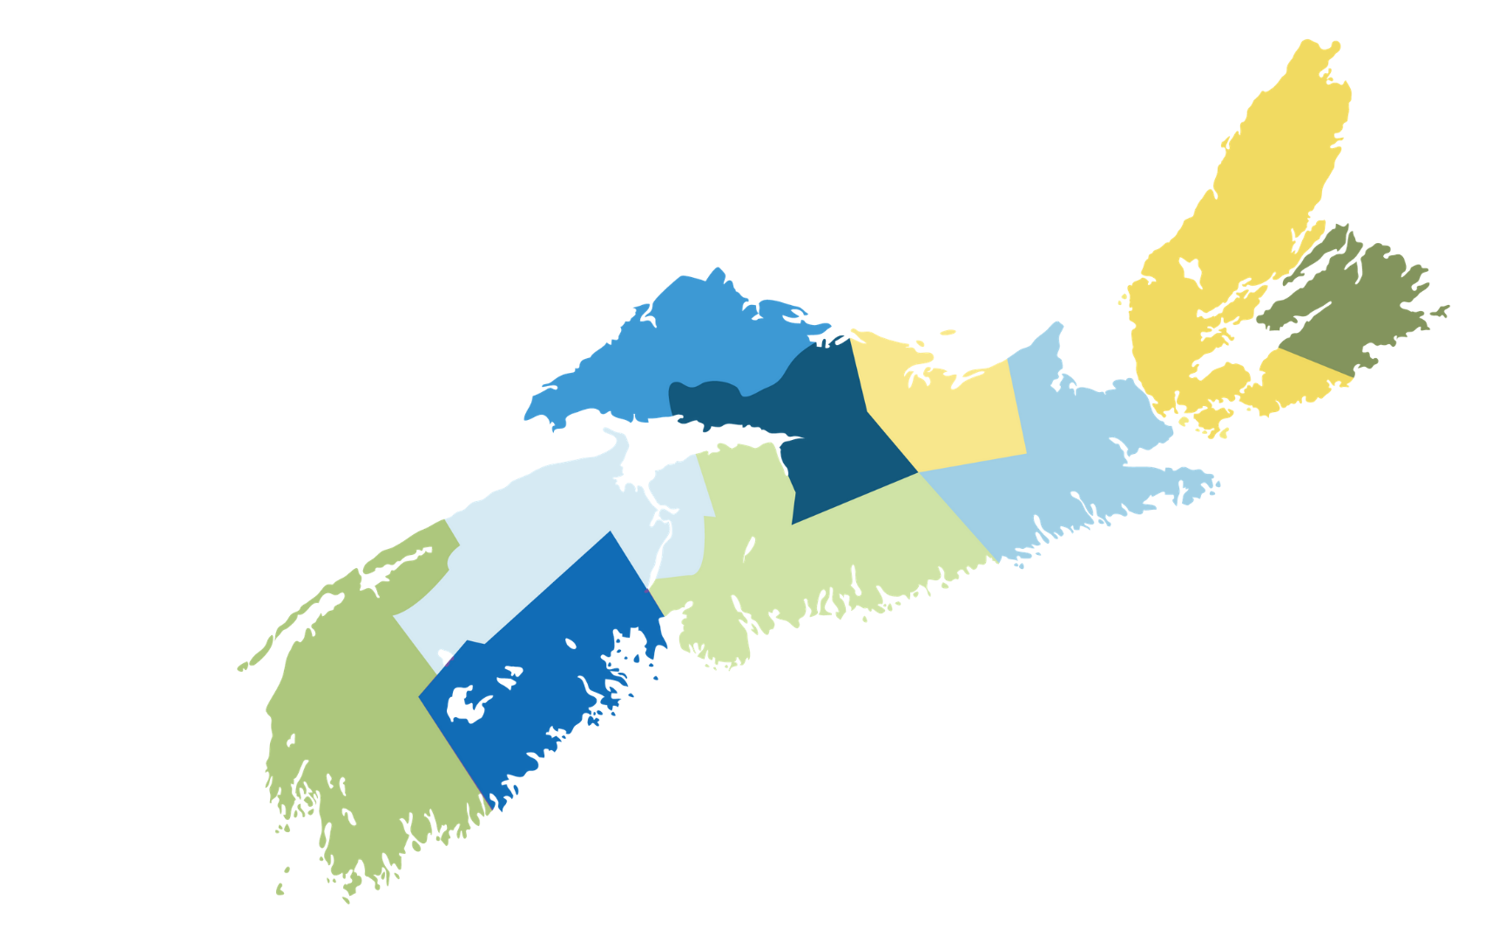
Nova Scotia Human Rights Commission Engage Nova Scotia
November 28, 2022

Slide 2
“We should measure Nova Scotia’s Success by…” (so we should measure both)
2020 Poll Results (post Covid)
58%
82%
2015 Poll Results
68%
81%
Growth in our economy
Improvement in our quality of life
Growth in our economy
Improvement in our quality of life

Slide 3
We equip
All Governments
All Sectors
All Regions
Individuals
with insights and tools about QOL
Special Thanks
NS Provincial Government
Nova Scotia Community College (NSCC)

Slide 4
Canadian Index of Wellbeing
(Univ of Waterloo)
Between May and July 2019, 1 in 5 households received an invitation in their mailbox to participate in a voluntary 230-question survey
Resurvey in 2024

Slide 5
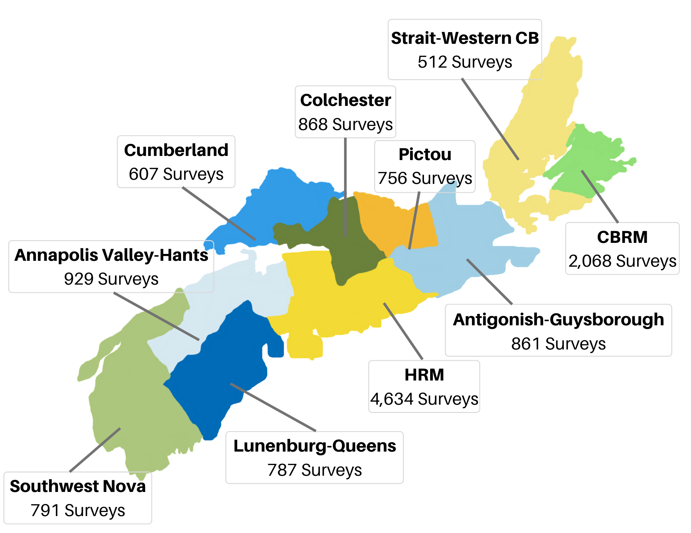
Largest Single Quality of Life ”Census” in Canada (StatsCan and CIW Review)
12,827 Responses (Pre-Covid)
230 Individual questions
16 years-old and above
1% Margin of Error (weighted)

Slide 6
NS Quality of Life Survey and CIW Domains
WHAT’S POSSIBLE?
Age
Income level
Gender
Level of education
Family profile
Disability
Housing situation
Race/Ethnicity
Community Vitality
Healthy Populations
Living Standards
Environment
Sense of belonging to community
Number of close friendships
Social isolation and trust in others
Inclusiveness of community
Trust in neighbours, media, business and NGOs
Volunteering
Feeling of safety in neighbourhoods
Experiences of discrimination
Mental and physical health
Access to, and quality of, health care
Level of exercise
Ate less and ate unhealthy
Substance abuse and gambling activity
Could not pay bills on time
Could not buy necessities
Access to, and quality of internet
Overall work satisfaction
Satisfaction with job, salary, security, promotion opportunities
Flexible work hours and schedule
Under-employment relative to training
Effects of job on personal health and wellbeing
Perceptions of water quality in community
Personal commitment to solid waste management and energy conservation
Access to, and quality of, natural environment
Eco-friendly commuting practices
Purchase of local foods
Democratic Engagement
Leisure and Culture
Education
Time Use
Trust in Local Government, Federal, Provincial
Confidence in Police, Justice, Schools and Health Care
Participation in public meetings
Participation in advocacy
Access to libraries and learning institutions
Participation in recreation, leisure, sports, and hobbies
Availability of adult education
Affordable education
Use of retraining opportunities
Time pressure for sleep, socializing, creativity and outdoors
Time caring for dependent children and adults
Notes:
Do we need this one?

Slide 7
Reports and tools Overview
Reports:
NS Quality of Life Index (2018)
Survey summary results (March 2020)
A Closer Look - Supplementary analysis (Fall 2020)
UN SDG - Survey Snapshots - infographic report (February 2022)
Tools:
Spotlight (Spring 2022)
Wellbeing Mapping Tool (Spring 2022)
Wellbeing Analysis Tool (Fall 2022)
(Data Sharing Agreements)
Notes:
Catherine

Slide 8
NS Quality of Life Survey and CIW Domains
WHAT’S MOST IMPORTANT?
Newcomer status
Age
Income level
Level of education
Family profile
Disability
Housing situation
Race/Ethnicity
Gender
Community Vitality
Healthy Populations
Living Standards
Environment
Sense of belonging to community
Number of close friendships
Social isolation and trust in others
Inclusiveness of community
Trust in neighbours, media, business and NGOs
Volunteering
Feeling of safety in neighbourhoods
Experiences of discrimination
Mental and physical health
Access to, and quality of, health care
Level of exercise
Ate less and ate unhealthy
Substance abuse and gambling activity
Could not pay bills on time
Could not buy necessities
Access to, and quality of internet
Overall work satisfaction
Satisfaction with job, salary, security, promotion opportunities
Flexible work hours and schedule
Under-employment relative to training
Effects of job on personal health and wellbeing
Perceptions of water quality in community
Personal commitment to solid waste management and energy conservation
Access to, and quality of, natural environment
Eco-friendly commuting practices
Purchase of local foods
Democratic Engagement
Leisure and Culture
Education
Time Use
Trust in Local Government, Federal, Provincial
Confidence in Police, Justice, Schools and Health Care
Participation in public meetings
Participation in advocacy
Access to libraries and learning institutions
Participation in recreation, leisure, sports, and hobbies
Availability of adult education
Affordable education
Use of retraining opportunities
Time pressure for sleep, socializing, creativity and outdoors
Time caring for dependent children and adults
Notes:
Do we need this one?

Slide 9
FOCUS ON NEW CANADIAN EXPERIENCES

Slide 10
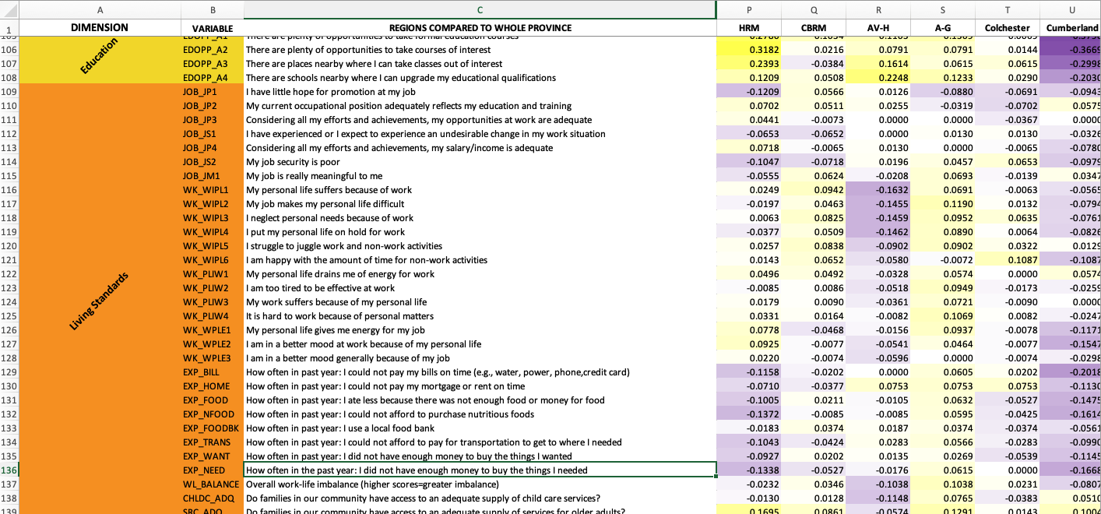
Spotlight Tool – Regions
Community Vitality | Healthy Populations | Environment | Democratic Engagement | Education | Leisure & Culture | Living Standards | Time Adequacy

Slide 11
THE IMPORTANCE OF COMMUNITY BELONGING, SOCIAL COHESION, AND TRUST

Slide 12
PRACTICAL ACTION ON SENSE OF COMMUNITY
CB LIP EXISTING INITIATIVES
SHARE THANKSGIVING
FROM ME TO YOUI
DO A___THING

Slide 13
LEARN MORE NOW

Slide 14
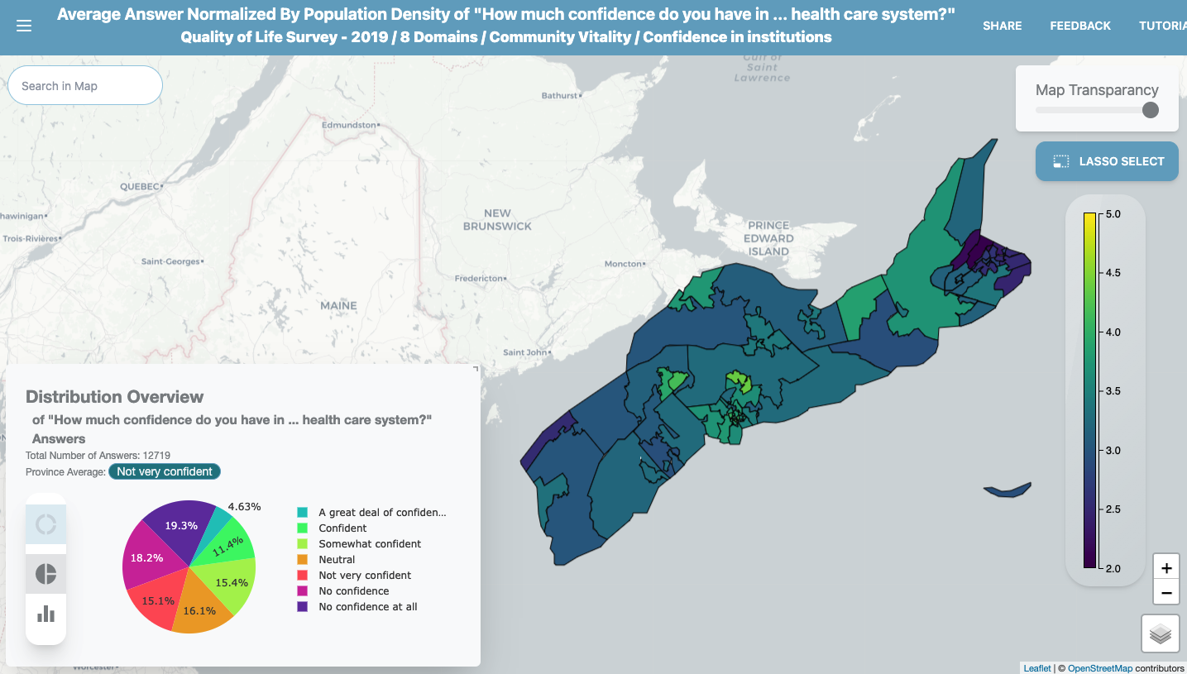
Wellbeing Mapping Tool – Confidence in Institutions (Healthcare)

Slide 15
THE ROAD AHEAD – 2024 SURVEY

Slide 16
Thank you!
Follow up
Danny Graham - dgraham@engagenovascotia.ca
Taylor Hill – research@engagenovascotia.ca

